Slide 1


VISUAL QUESTION ANSWERING DEEP LEARNING MODEL SOLUTION
Zikora Orakwe

Slide 2






Plan
Build a VQA system to interpret images and answer questions
Architecture includes CNN for image processing, text embeddings and attention mechanisms
Accuracy, loss Function, F1 Score,
Data cleaning, image transformation, tokenization and feature extraction.
Model interpretability, ethical considerations, bias mitigation. Deployment in real-world applications
Images, Questions and Annotation (answers) dataset.
Business Understanding:
Data Preparation for Deep Learning:
Evaluation:
Deployment and Next Steps:
Data Understanding:
Modelling:

Slide 3
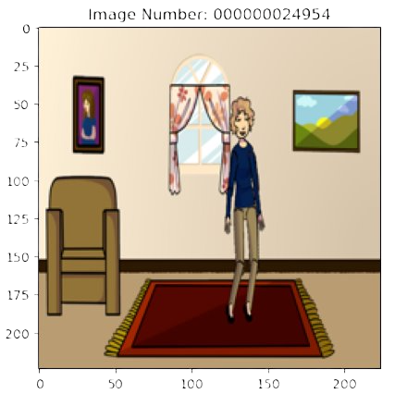
Overview of Training & Validation Data
Images
File Name Reflects Image ID
20,000 Images (Training)
Questions
60,000 Questions (Training)
30,000 Questions (validation)
Annotations
Ground Truth Labels
10,000 Images (Validation)
18 multiple choices/ Question
Abstract Art
RGBA Format
3 Questions/Image

Slide 4
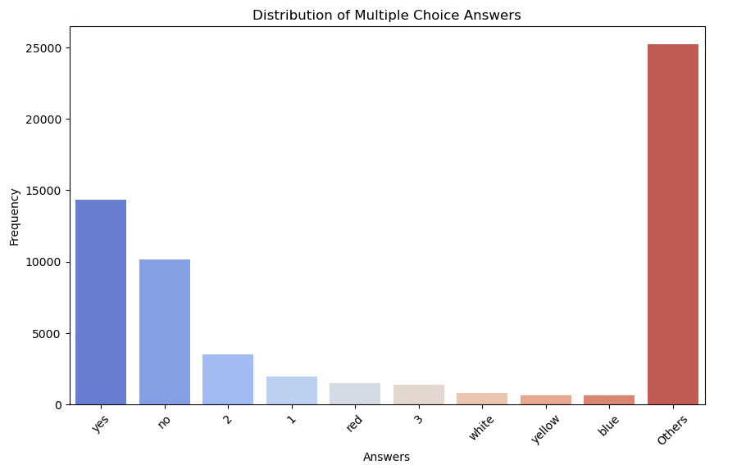
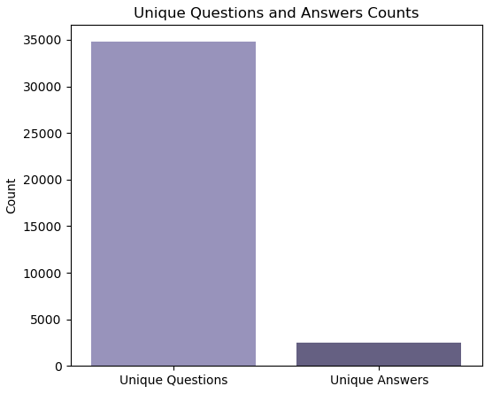
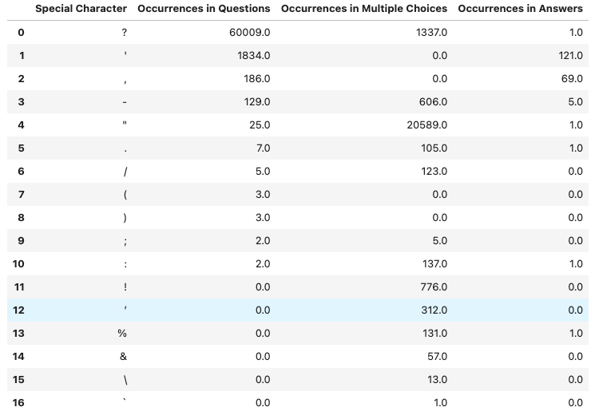
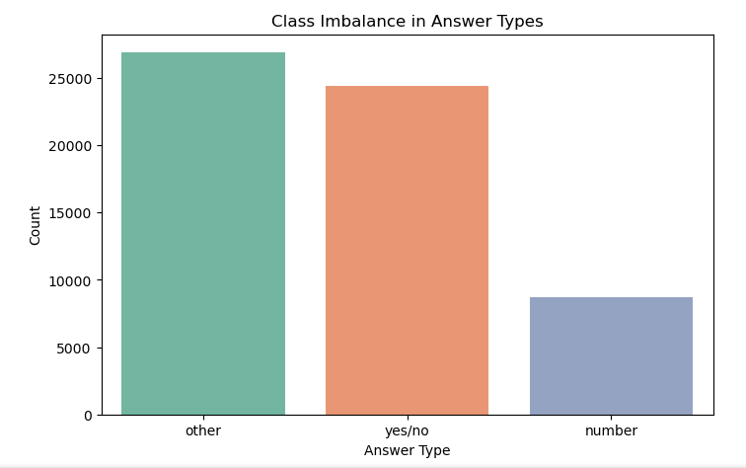
Exploratory Data Analysis
Special Characters
Leading Trailing Spaces
Capitalization
Stop Words
Class Imbalance
Grouping Rare answers: 1% Threshold

Slide 5
Exploratory Data Analysis
Direct Questions:
"Who looks happier?" or "Where is the woman sitting?".
Identification tasks where the model just needs to find an object in the image and return a label.
Counting Questions:
"How many people are sitting?"
These are more complex because they require the model to first identify the relevant objects and then count them.
Temporal and Spatial Questions:
"What time is it?" or "Where is the table in relation to the chair?"
Understanding spatial or temporal information from the image and pairing it with the textual question.
Types of Questions:
Simple Answers:
These involve one-word or binary responses (e.g., "yes", "couch").
Complex Answers:
These include quantitative, temporal, and spatial data (e.g., "5 feet", "3:00 PM", "2nd from bottom").
These answers require the model to understand both the numeric and qualitative aspects of the answer
Types of Answers
Compound Answers:
These answers (e.g., "1 table", "5 feet") require careful tokenization to ensure both the numeric and qualitative parts are preserved.
Ensuring proper tokenization of the numbers and units (e.g., "5 feet" as one token), so the model can learn to pair them appropriately.
Temporal and Spatial Answers:
The model will need to learn from the dataset how to handle both numbers and units.
Fine-tuning on questions involving temporal (e.g., "What time is it?") and spatial reasoning (e.g., "Where is the chair located?") will be critical.
Handling of Answer Complexity:

Slide 6
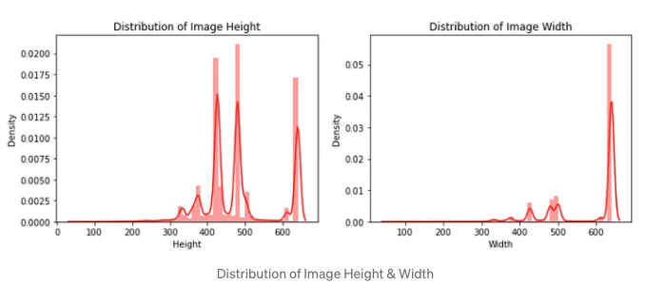

Data Processing
Dimensions
(244,244)
RGBA
Remove Alpha Channel
(244,244,3)
Lack of uniformity in the image height & weight
Normalization
Dictionary Look Up
Tensor / 255
Load Image arrays into a dictionary
Key: Image_ID
Value: Image Array
Normalize

Slide 7
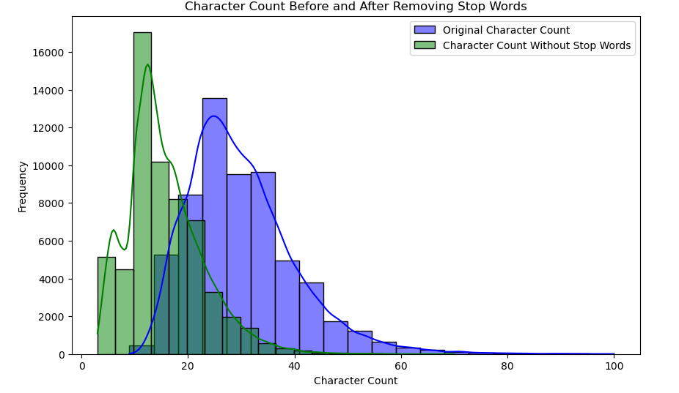
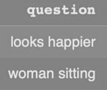
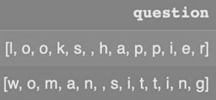
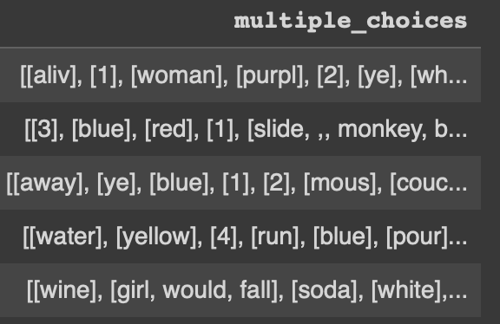
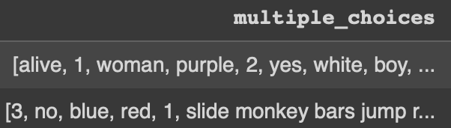
Stop Words, Lemmatization, Stemming
Stop words are commonly used words (such as "the", "is", "in", "and") that are typically removed from text data during natural language processing because they do not add significant meaning or value to the analysis.
Stemming : Given rules to slice a string: Example: Removing "S", "es" that indicates that a word is a plural. Also removing past tense like "ed”
Lemmatization:
May lose subtle differences in meaning (e.g., "running" vs. "ran")​
Lemmatization before Vectorization is common practice with traditional methods like TF-IDF or CountVectorizer​
Lemmatization after Vectorization preserves contextual information from embeddings like Word2Vec or GloVe​

Slide 8
Data Encoding & Tokenization
Transformers - (ex: BERT) Model
Classical (ex: RNN – LSTM) Model
Text Data Encoding & Tokenization
Bert Base Uncased
Each word converted into a token ID from the BERT vocabulary
A binary mask to separate real tokens (1) and Padded tokens(0) during BERT processing
Padding & Truncation:
Tokenized text sequences padded or truncated for equal length
Input IDs:
Attention Mask:
Image Data Encoding:
Resizing, Normalization and Batch Tensor Formation for input to VGG-16, Resnet, Efficientnet
Multilabelbinarizer:
Image Data Encoding:
Applied to encode the multiple choice options
LabelEncoder:
One-hot Encoding:
Tokenizer(), Padding & Sequencing:
Applied on the multiple choice answers
Applied on the image IDs
The questions were vectorized, padded and put in the right sequence for deep learning
Resizing, Normalization and Batch Tensor Formation for input to VGG-16

Slide 9
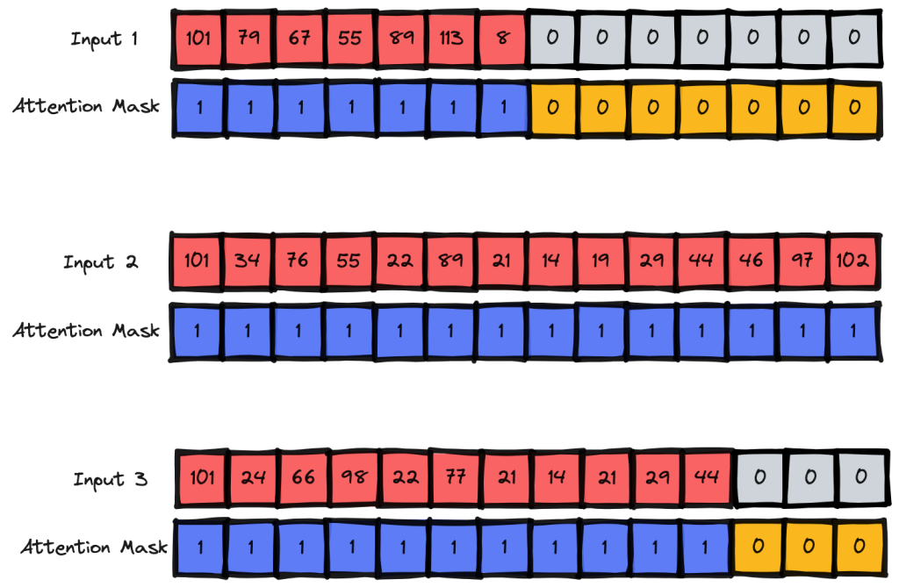
Tokenization, Padding & Sequences
Transformers - (ex: BERT) Model
question | multiple_choices
is the floor messy? | [wild, 1, white, blue, sofas, yellow, news, 4...]
what color is the chair? | [cookie, black, yellow, to sit on, white, 4 y...]
what food is being cooked on the grill? | [no, 3, breakfast, red, yes, 4 yellow, rocks,...]
what is the door handle made of? | [red, yes, wood, blue, 3, metal, sideways, bra...]
what is walking on the edge of the pond? | [no, cat, 4, yes, benches, 3, yellow, blue, be...]
Tokenization: Individual data extracted from the sentence (words extracted from a sentence)
Texts-to-sequences: Part of the networks often require inputs of uniform size.
Pad-sequences: ensures all sequences are the same length, adding padding, as necessary.
input_ids | attention_mask
[[101, 2003, 1996, 2723, 18307, 1029, 102, 374...]] | [[1, 1, 1, 1, 1, 1, 1, 1, 1, 1, 1, 1, 0, 0, 0...]]
[[101, 2054, 3609, 2003, 1996, 3242, 102, 102...]] | [[1, 1, 1, 1, 1, 1, 1, 1, 1, 1, 1, 1, 1, 1, 0...]]
[[101, 2054, 2833, 2003, 2108, 12984, 2006, 1...]] | [[1, 1, 1, 1, 1, 1, 1, 1, 1, 1, 1, 1, 1, 0, 0...]]
[[101, 2054, 2093, 1996, 2341, 5047, 2081, 19...]] | [[1, 1, 1, 1, 1, 1, 1, 1, 1, 1, 1, 1, 1, 0, 0...]]
[[101, 2054, 2033, 3788, 2006, 1996, 3341, 199...]] | [[1, 1, 1, 1, 1, 1, 1, 1, 1, 1, 1, 1, 1, 1, 1...]]
multiple_choice_answer | question_id | image_id | label
yes | 125242 | 12524 | 17
blue | 102012 | 10201 | 16
Choice Number | Decoded Text
Choice 1 | is the floor messy? wild
Choice 2 | is the floor messy? white
Choice 3 | is the floor messy? blue
. . . | . . .
Choice 16 | is the floor messy? its circled
Choice 17 | is the floor messy? yes
Choice 18 | is the floor messy? ?

Slide 10
Methodologies
Layers | Training Time | Data Size | Epochs | Training Score | Validation Score | Loss Functions | Parameters
CNN: [5 layers], LSTM: [3: Tune- 2-3] | 5 - 15 mins / epoch | 50% | 20 | 35% | 5% | Cross-entropy, used logits | ~3 million
VGG: [16: Tune- 10-15], LSTM: [3: Tune- 2-3] | 2 – 4 mins / epoch | 50% | 100 | 100% | 56.% | Sparse_categorical_crossentropy | -26 million
ResNet50: [50: Tune- 40-50], LSTM: [3: Tune- 2-3], Fusion 2 layers (Concat) | 5 - 15 mins / epoch | 50% | 20 | 55% | 38% | Cross-entropy, used logits | ~26 million
VGG: [16: Tune- 10-15], BERT: [12: Tune- 9-12], Fusion 2 layers (Point Wise Multiplication) | 20 - 40 mins / epoch | 100% | 20 | 69% | 45% | Cross-entropy, used logits | ~150 million
VGG: [16: Tune- 10-15], BERT: [12: Tune- 9-12], Fusion 3 layers (Concat) | 20 - 40 mins / epoch | 100% | 20 | 65% | 27% | Cross-entropy, used logits | ~150 million
VGG: [16: Tune- 10-15], BERT: [12: Tune- 9-12], Fusion 2 layers, Weighted Sampler, Gated Mechanism (Projected Embedding) | 20 - 40 mins / epoch | 100% | 20 | 45% | 28% | Contrastive loss, cosine similarity, logits | ~152 million
VGG: [16: Tune- 10-15], BERT: [12: Tune- 9-12], Fusion 3 layers, Weighted Sampler, Gated Mechanism | 20 - 40 mins / epoch | 50% | 20 | 80% | 30% | Cross-entropy, used logits | ~150 million
VGG: [16: Tune- 10-15], BERT: [12: Tune- 9-12], Fusion 3 layers, Gated Mechanism | 20 - 40 mins / epoch | 100% | 75 | 75% | 59% | Cross-entropy, used logits | ~150 million
VGG: [16: Tune- 10-15], BERT: [12: Tune- 9-12], Fusion 3 layers, Weighted Sampler, Gated Mechanism | 20 - 40 mins / epoch | 50% | 20 | 50% | 41% | Cross-entropy, used logits | ~152 million
ResNet50: [50: Tune- 40-50], VisualBERT: [12: Tune- 9-12] | 20 - 40 mins / epoch | 100% | 20 | 78% | 25% | Cross-entropy, used logits | ~122 million
EfficientNet: [X layers: Tune- last 4], VisualBERT: [12: Tune- 9-12] | 20 - 40 mins / epoch | 100% | 20 | 75% | 35% | Cross-entropy, used logits | ~105 million
VGG: [16: Tune- 10-15], VisualBERT: [12: Tune- 9-12] | 20 - 40 mins / epoch | 100% | 20 | 68% | 28% | Cross-entropy, used logits | ~150 million
EfficientNet: [X layers: Tune- last 6], VisualBERT: [Tune 2] | 20 - 40 mins / epoch | 100% | 20 | 85% | 64% | Cross-entropy, used logits | ~105 million

Slide 11
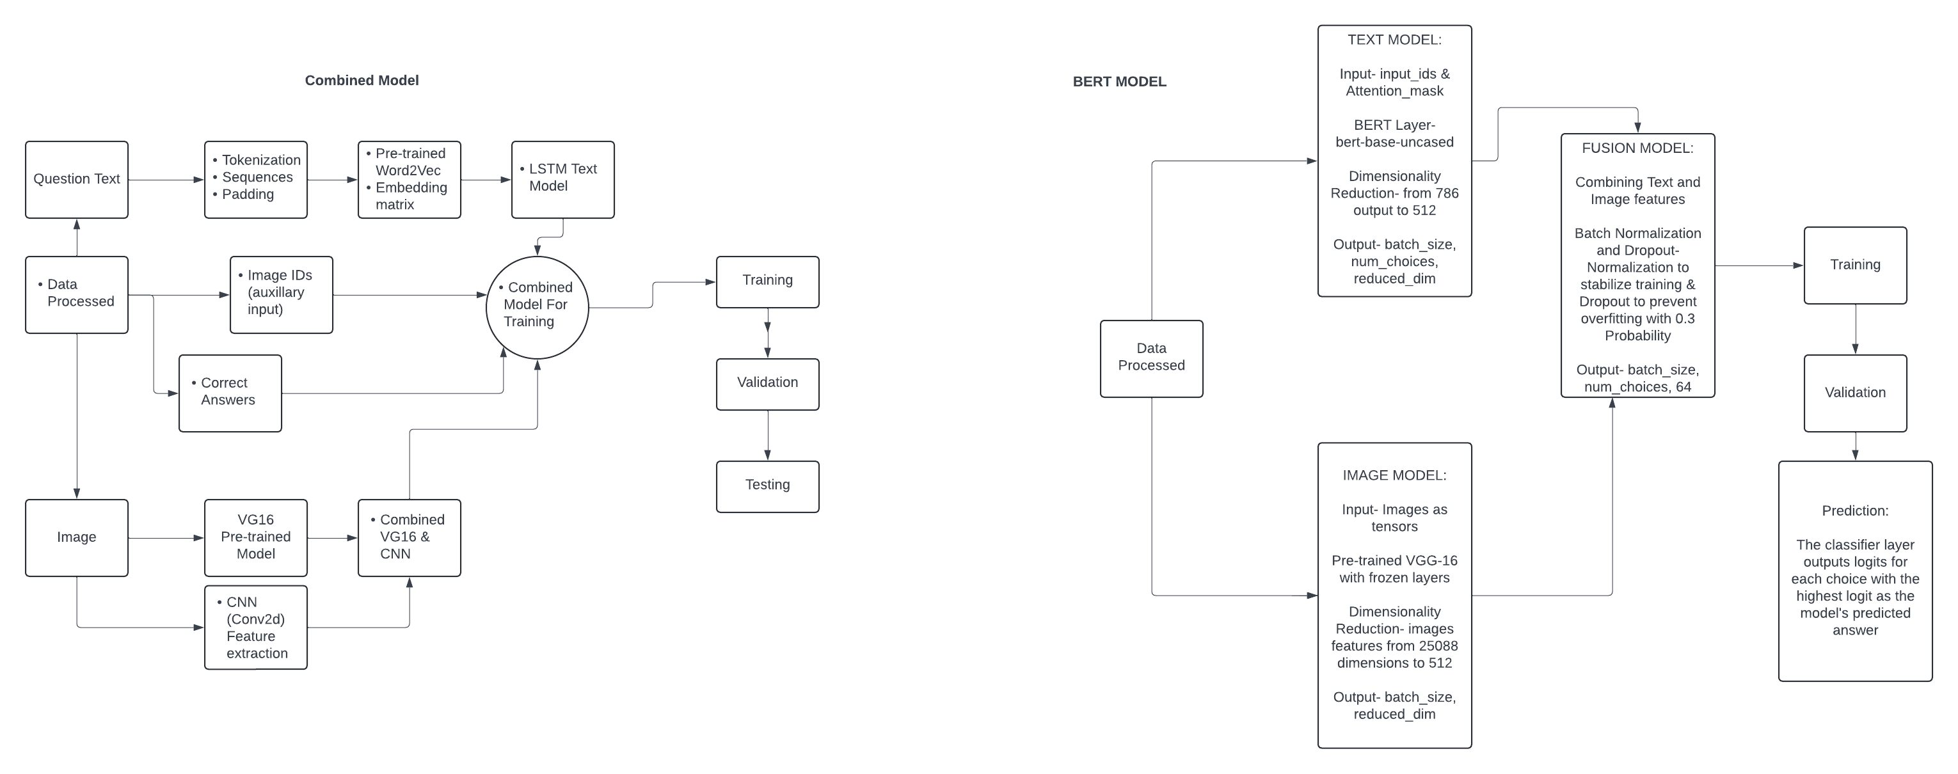
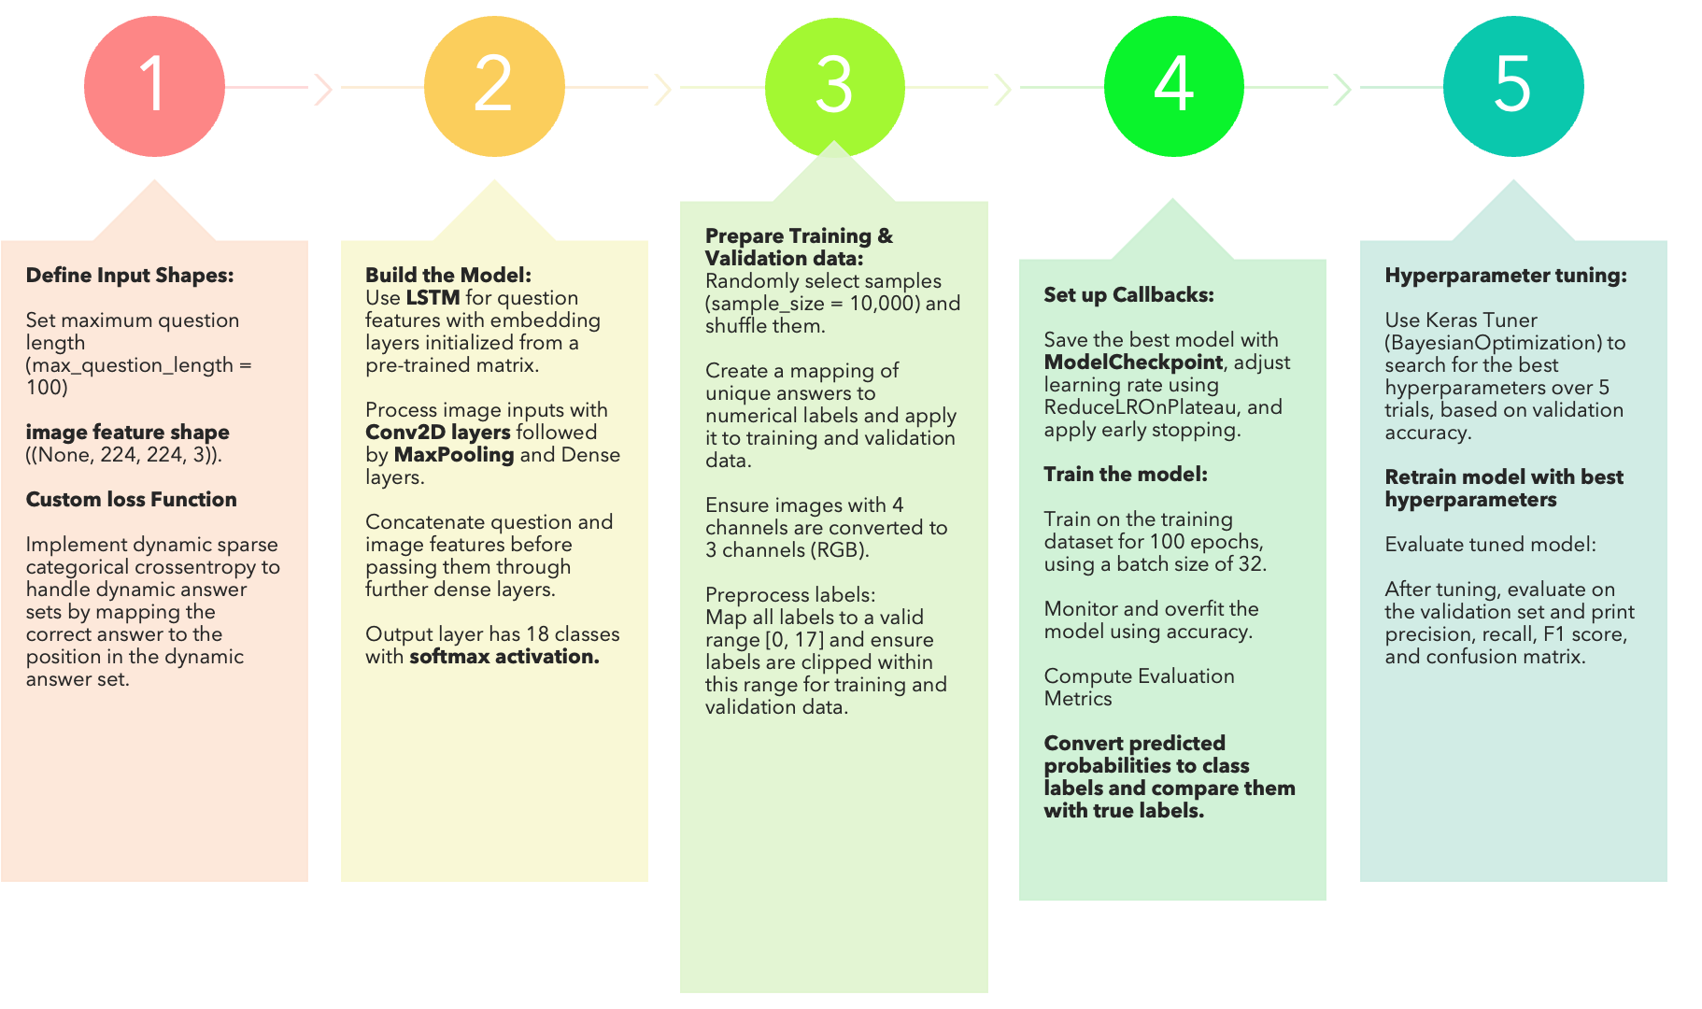
Model Architecture
Training Flow

Slide 12
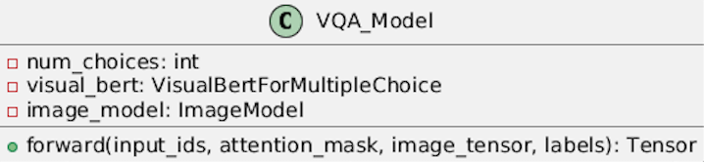
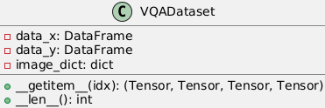
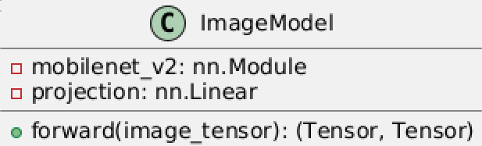
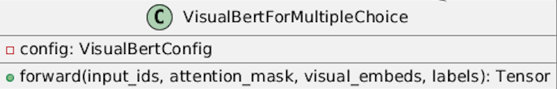
Model Architecture
Data X
Data Y
Image_dict
Input Id's
Image ID
Image ID
Attention Mask
Label
Question ID
Question ID
Image Tensor
2.1 | -1.1 | 2.5 | 0.5 | 0.2 | 0.9 | 0.1 | 0.8 | -5.5 | -7.8 | 1.8 | 9.2 | 5.6 | 7.8 | 8.9 | -0.7 | 0.89 | 0.61
Outputs: Loss & Logits (cross-entropy – Label smoothing)
Image Model
Remove fully Connected Layers
Unfreeze Last 6 Layers of Efficient Net – Tuned
Linear Projection to 512 dimensions
Learning Rate 1e-5
Text & Fusion Visual Bert
Pretrained VQA-pre
Unfreeze Last 2 Layers of Visual Bert Encoder Named Parmeter Layers
Drop Prob Increased 0.3 attention Head
Drop out Prob Increased to 0.2 Hidden Layer’s
1e-6 learning rate
20% data augmentation (Brightness, contrast, saturation, hue)

Slide 13
Visualizing the Process
X 12
Visual Bert Embedding Layers
Fusion Layer (Combines Text + Image)
Multi-head Attention
Feed-Forward Hidden Layers
Residual Connections & Layer Normalization
Logits Num Choices
[num_choices, seq_length]
Question: "How many apples are there?"
Choices: ["one", "two", "three", "four"]
Tokenization & Attention Mask
BERT
Loss
Text Embedding
[batch_size, channels, height, width]
Image
Resize & Normalize - Tensor
Efficient Net
Image Embedding
Expand
[batch_size, num_visual_tokens, visual_embedding_dim]
[batch_size, num_choices, num_visual_tokens, embedding_dim]

Slide 14
Training Flow
Tokenization outside model
Image resizing/normalization outside model
Model Setup
Preprocess text into tokens
Preprocess images to a uniform size and format
Stored in dictionaries for O(1)
Gradual image layer unfreezing
Adjust every 5 epochs
Training and Visualization
Freeze embeddings to retain core language understanding
Reduced attention heads and hidden layers
TensorBoard for real-time visualization of loss, accuracy, feature maps
Visualize and monitor training dynamics like gradient flow
Experimentation
Tested various optimizers, adjusted learning rates dynamically, tuned weight decay for regularization
Label smoothing improves generalization, reducing overconfidence in predictions
Used Optuna
Begin with 500 samples to test setup,
Stored in a dictionary (O(1) lookup)
VisualBERT Setup
Scaling Data
scaling up to 5k, 30k, 60k
Pin Memory for Faster Data Transfer (CPU to GPU)
Automatic Mixed Precision (AMP)
Gradient Checkpointing
Locks the memory pages in RAM, ensuring the data is readily available and can be transferred faster between the CPU and GPU.
Mixed precision training, using half-precision (16-bit) floating-point numbers where possible, and full precision (32-bit) where necessary.
Only saves a few strategically placed activations and recomputes the others during the backward pass.
Learning Rate Scheduler
The learning rate scheduler helps dynamically adjust the learning rate during training to prevent overshooting or stagnation.
TRIAL & ERROR
DONT GIVE UP
Tensorboard
use Tensor board for logging feature maps and attention maps

Slide 15
Metrics
Accuracy
Loss
Other Metrics (Precision, Recall, F1)
Measures how often the model selects the correct answer out of multiple choices, making it the most direct and intuitive way to evaluate performance.
Guides training by showing how confident the model is in its predictions. Lower loss means the model is learning and improving.
Less relevant in VQA because they focus on error types (false positives/negatives), which aren't critical for multiple-choice tasks.
Why These Metrics
Accuracy
Measures Direct Success: In a multiple-choice task, accuracy tells you exactly how often the model selects the correct answer. If the model picks the right option out of the given choices, it is a straightforward measure of success.
Easy to Interpret: Accuracy is an intuitive metric—both technical and non-technical stakeholders can understand it easily. A higher accuracy directly indicates better performance.
Matches the Objective: Since the model’s goal is to choose the correct answer from a set of options, accuracy directly aligns with this goal. It answers the question, "How often did the model get it right?"
F1 Score:
F1 is the harmonic mean of precision and recall and is most valuable when there’s an imbalance between false positives and false negatives.
In VQA, the focus is on choosing the correct answer, and accuracy provides a direct measure of this.
The notion of "balance" between false positives and negatives isn't as relevant for multiple-choice problems.
Future Integrations:
BLEU Score (Bilingual Evaluation Understudy): Often used in natural language generation, BLEU compares the predicted answer with the ground truth using n-grams. It's suitable for assessing how similar the predicted answer is to the reference.

Slide 16
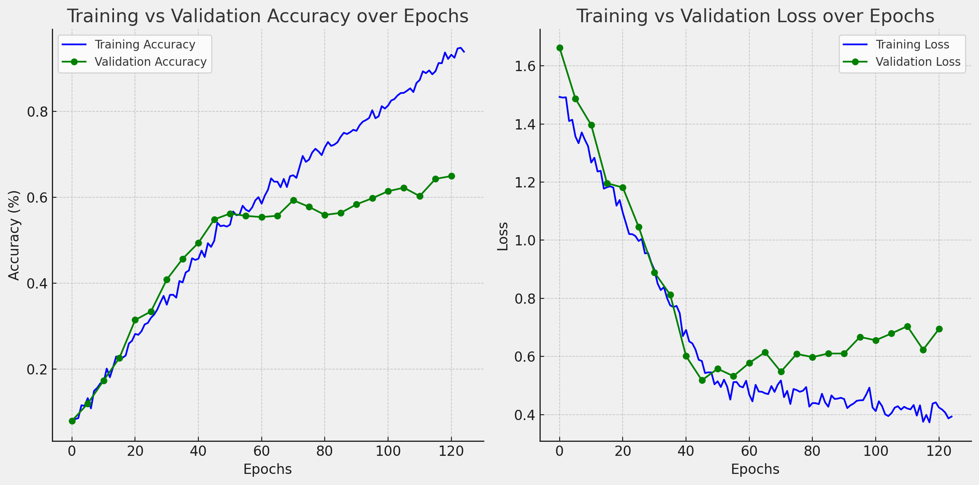
Evaluation
Oscillations: The oscillations in accuracy (the bouncing up and down) are due to the model's ongoing adjustment to the data. It tries to find the best fit, but certain epochs may slightly overfit or underfit, causing fluctuations.
Training Accuracy: These oscillations are more common in training as the model is fine-tuning itself on the training set.
Validation Accuracy: The validation set is unseen during training, so its accuracy tends to fluctuate more as the model may struggle to generalize.
Convergence Point: Around "120" epochs, training accuracy stabilizes near 85%, while validation accuracy reaches around 64%
Transformer – Visual Bert
Classical Approach
Metrics​ | No FE​ | Stop​ Words​ | Stemming​ | Lemmatization​
Loss​ | 7.81​ | 6.55​ | 6.37​ | 6.61​
Accuracy​ | 50.07%​ | 50.13%​ | 52.16%​ | 51.56%​
F1 score​ | 64.89%​ | 64.52%​ | 66.62%​ | 66.39%​
Tuned​ Loss​ | 10.08​ | 6.99 | 5.99​ | 4.77​
Tuned ​ Accuracy​ | 50.14%​ | 54.25% | 54.03%​ | 56.03%​
Tuned​ F1 Score​ | 64.91%​ | 68.02% | 67.87%​ | 69.77%​

Slide 17
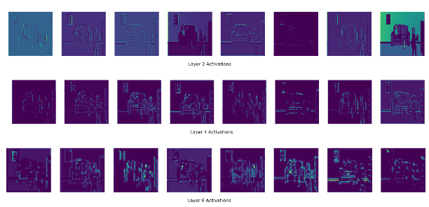
Next Steps and Limitation
Gradient Clipping
Large Gradients – leading nan Loss
Compute Power
A100 GPU – 40GB of GPU Ram & 80GB of system Ram
$495 Spent
GPU Ram Fragmentation – Memory Leak Debugging
Increase batch size
Implement Gradient Accumulation
Add Weighted Sampler Again
Use larger & better Image model, Tune more Layers
TensorBoard for attention Map's and Feature Maps
Compute Power
Training DATA
COST
Batch Size
Combat Data Imblance
Pre trained Feature Extraction
Lamb Optimization – Larger Batch sizes
$495 Spent on Compute

Slide 18
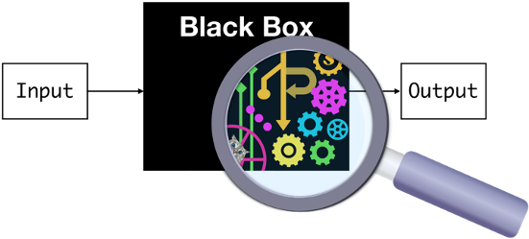
Challenges in Interpretability & Production Deployment:
Complexity of Model Architecture: Models like VisualBERT use deep layers (transformers, CNNs), making it difficult to interpret how decisions are made or why specific answers are chosen.
Black-box Nature: The model combines visual and textual data, which obscures which features (image regions or text tokens) are most influential in predictions.
Limited Explainability: It's hard to trace why one answer is favored over another in multiple-choice VQA tasks, making debugging or compliance with transparency standards difficult.
Inconsistent Generalization: The model may struggle with new-data that differs slightly from training examples, leading to unpredictable behavior when deployed at scale.
Resource Intensive: Visual models often require significant computational power (GPUs) and can be slow, which increases costs and complicates real-time deployment in production environments.
Uncertainty in Edge Cases: For ambiguous or complex questions, the model’s confidence may not align with actual correctness, making it risky for critical applications.
The combined model made interpretation easier compared to the transformer model
However, Neural network explainability is limited as it is difficult to comprehend what happens under the hood
The healthcare and Financial sectors would struggle with our model as it will be difficult to explain to their stakeholders that require explanation in full detail

Slide 19
Ethical Considerations in Deploying VQA Models:
Compute Power & Carbon Footprint
High Energy Consumption: Training large models like VisualBERT requires substantial computational resources, often using GPUs. This contributes to significant energy usage and an increased carbon footprint.
Bias in Data
Training Data Bias: Predictions reflect the biases present in the training data.
Fairness & Equity
Transparency & Accountability
Lack of Explainability: The black-box nature of deep learning makes it hard to explain how decisions are made, which can raise accountability concerns, particularly in regulated industries like healthcare or legal services.
Ethical Deployment
Sustainability Concerns
Unintentional Discrimination: Systematically perform better on certain types of images or questions based on training data, disadvantaging underrepresented scenarios.
Differential Performance: The model may work well for certain types of queries (e.g., simple questions or clear images) but poorly for others (e.g., complex or ambiguous questions), creating inequities in access to accurate information.
Over-reliance on Automation: Deploying such models for decision-making without human oversight can lead to incorrect or harmful outcomes if the model misinterprets the input data.
Gender Bias in data

Slide 20
The End
Questions?

Slide 21
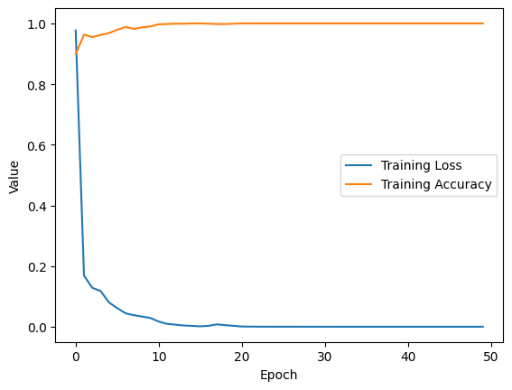
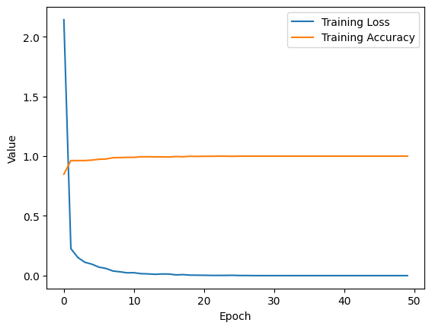
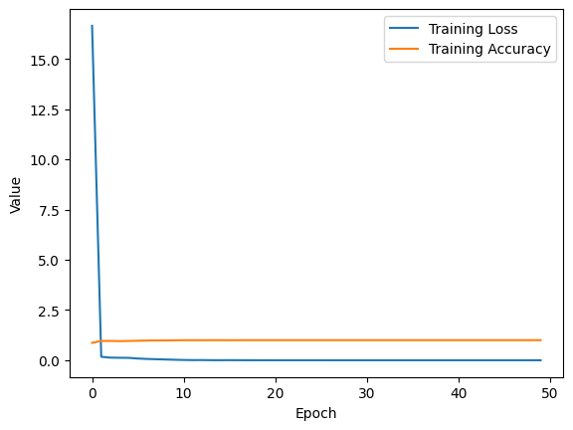
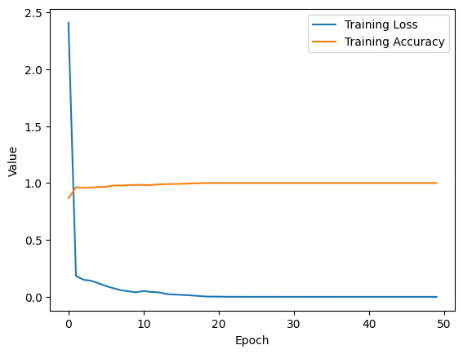
Relevant Business Metrics Combined Model
No Feature Engineering
Stop Words
Stop Words & Stemming
Stop Words, Stemming, Lemmatization

